Slide 1

April 18, 2019
Wii: 1393Conference
Password: kayla1393

Slide 2

Welcome & Introductions
www.lihealthcollab.org

Slide 3
LIPHIP Funding Restored
www.lihealthcollab.org

Slide 4
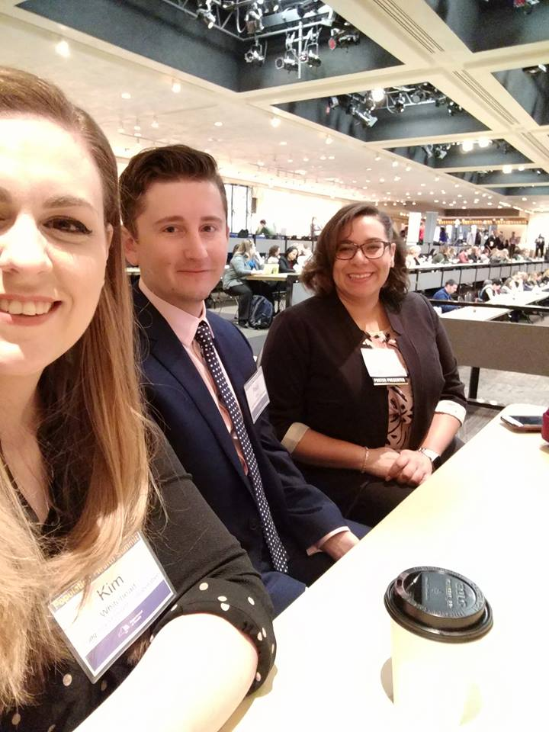
Things to Note
Population Health Summit VI: “Becoming the Healthiest State for People of All Ages - Incorporating Health Across all Policies and Age Friendly principles into the Prevention Agenda 2019 - 2024”
www.lihealthcollab.org

Slide 5

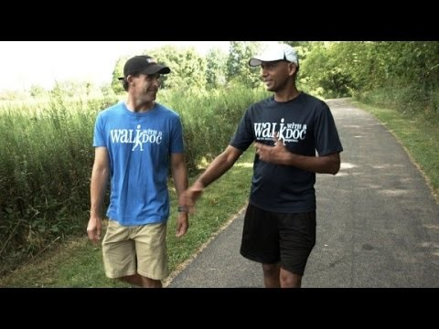
Things to Note
Walk with a Doc
www.lihealthcollab.org

Slide 6
CHNA Priorities selected
March 29th - LI hospitals and the two county health departments selected two priorities from the Prevention Agenda
Prevent Chronic Disease
Chronic Disease Preventive Care and Management
Promote Well-Being and Prevent Mental and Substance Use Disorders
Mental and Substance Use Disorders Prevention
www.lihealthcollab.org

Slide 7

Networking Break
www.lihealthcollab.org

Slide 8
Walk Safe Long Island
Cynthia Brown
Executive Director
New York Coalition for Transportation Safety cbrown1@nassaucountyny.gov
www.lihealthcollab.org

Slide 9
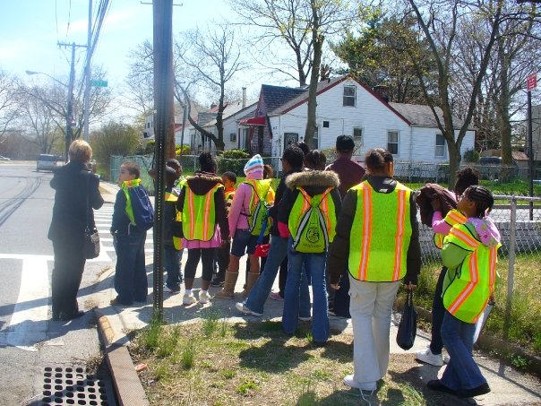
PEDESTRIAN SAFETY
IN NASSAU AND
SUFFOLK COUNTIES

Slide 10
New York State Invests $62 Million for Pedestrian Safety Upgrades
Total Long Island Funding $12.78 Million
Suffolk County:
$2.78 million for Phase 1 of Pedestrian Signal Improvement +
$4.14 million for Phase 2 of Pedestrian Signal Improvement:
Towns of Huntington, Islip, Brookhaven, Smithtown, Babylon, Riverhead and Southampton
$1.32 million to the town of Brookhaven for safety improvements at uncontrolled crosswalks.

Slide 11
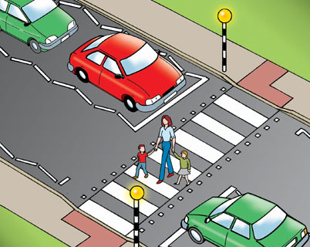
Nassau County $4.22 Million
For safety improvements at uncontrolled
crosswalks.
Locations:
Towns of Hempstead, Oyster Bay and
North Hempstead
Village of Freeport
City of Glen Cove

Slide 12
PEDESTRIAN CRASHES INCREASED SIGNIFICANTLY IN LAST 5 YEARS
Pedestrians accounted for 31% of motor vehicle fatalities in NY State in 2016 (ITSMR).
Nassau and Suffolk Counties are overrepresented for pedestrian injuries and fatalities. Within those counties the following communities have the highest incidences of deaths and injuries (in rank order):
1). Town of Hempstead 5). North Hempstead
2). Brookhaven 6). Babylon
3). Islip 7). Huntington
4). Oyster Bay 8). Freeport

Slide 13

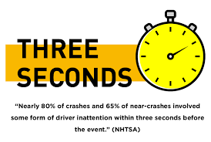
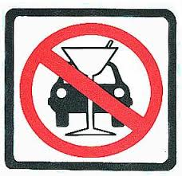


CONTRIBUTING FACTORS

Slide 14
SOLUTIONS
ENGINEERING
EDUCATION
ENFORCEMENT
Education
NY Coalition for Transportation
Safety
Long Island Health Collaborative
Cohen’s Children's Medical Center
Community Parent Center
DEDICATEDD

Slide 15
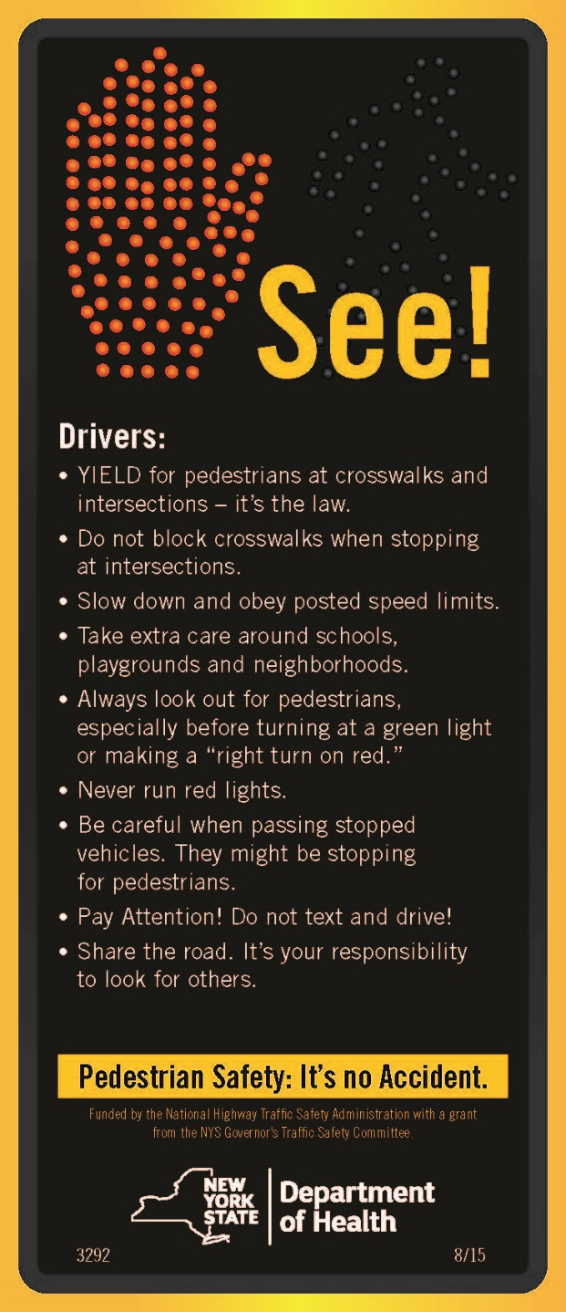
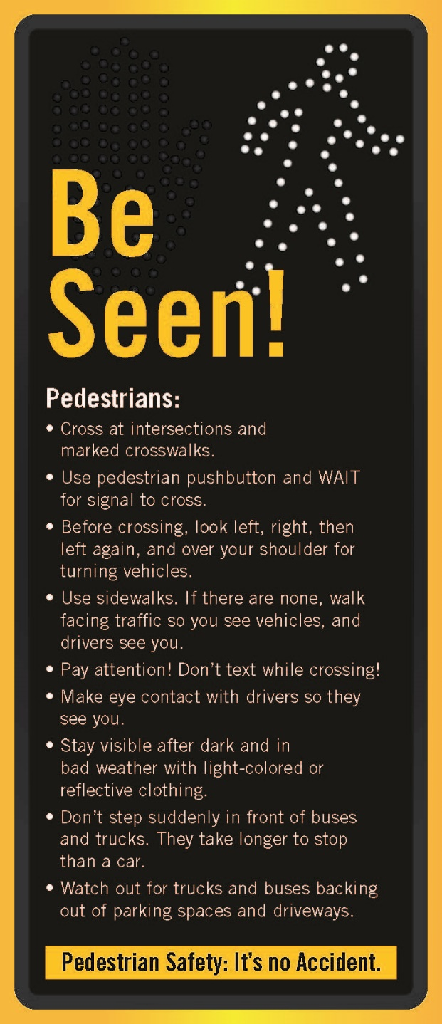
This is the theme of the educational campaign. The cards are available at no cost from the NY State Department of Health. For more information please call 518-402-7900 or email injury@health.ny.gov.
For further information or to request a speaker contact
Cindy Brown, NY Coalition for Transportation Safety,
516-571-6808 or email
cbrown1@nassaucountyny.gov

Slide 16
Walk Safe Long Island
www.walksafeli.org [link]
www.lihealthcollab.org

Slide 17
2019 Meeting Dates
Wednesday, June 12*
Wednesday, August 7
Wednesday, October 16
Thursday, December 12
*CHS Melville
www.lihealthcollab.org

Slide 18
Adjournment
www.lihealthcollab.org

